Slide 1
Spray Training for Paint Technicians
EPA 6H Part 2

Slide 2
Training Objectives
Paint Technicians successfully completing this update will be able to:
Determine if their job tasks make them subject to this EPA Rule
Identify coatings that are subject to this EPA Rule
Select equipment that is compliant under this EPA Rule
Describe regulations regarding spray booth operations and filter maintenance as required by the EPA Rule
Select compliant spray guns, fluid tips, and gun set-ups for the products they use
Make adjustments to their spray technique to maximize efficiency and minimize overspray
Identify compliant methods for cleaning spray guns

Slide 3
Spray Gun Topics
Topics:
General practices for spray gun set-up and adjustments/Spray Pattern
High Volume Low Pressure (HVLP) vs. Transfer Efficiency (TE)
Air Volume vs. Air Pressure differences
Air Lines / Air Fittings
Fluid tip selection and Viscosity
Overlap and distance off the panel
Gun cleaning

Slide 4
Spray Gun Set-up and Adjustments
General Practices For Best Transfer Efficiency*:
Pick the correct nozzle set-up per product recommendations
Reduce product to recommended viscosity. Additional solvent may exceed VOC limits
Set fan control and fluid control knobs to wide open
Set incoming air pressure at maximum psi per spray gun manufacturers recommendations
Spray test pattern
Adjust fan control and air pressure if needed
Spray panel with 65 – 75% over lap
*Transfer efficiency – “the volume of coating deposited as part of the paint film as a fraction of the volume of paint sprayed”

Slide 5

Test the Spray Pattern
Adjust gun to get a good spray pattern
Close and wet
Center blow out
Courtesy of SATA

Slide 6
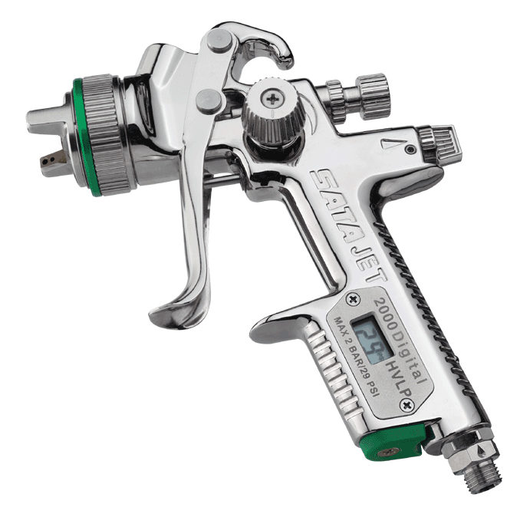
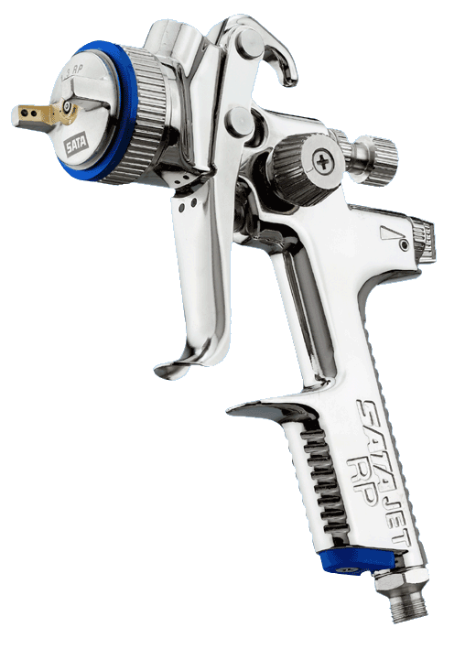
HVLP vs. Transfer Efficiency Guns
HVLP
Better Transfer Efficiency
VOC Compliant in all areas
Requires higher cfm of air delivery
Lower air pressure at the air cap
Better for matching OEM texture
Transfer Efficiency
Lower Transfer Efficiency
Not VOC Compliant in all areas
Requires lower cfm of air delivery
Higher air pressure at the air cap
Achieves better than OEM finish
Spray application faster
Courtesy of SATA

Slide 7
Air Volume vs. Air Pressure
HVLP
Required cfm: 15.2
Air pressure: 10 psi at the cap
Inlet pressure: 29 psi
Transfer Efficiency
Required cfm: 10.2
Air pressure: 29 psi inlet pressure
These are SATA recommendations for NR 5000 and RP spray guns. Other spray gun manufacturers may be different. Check all recommendations before using any spray equipment for best results.
Courtesy of SATA

Slide 8
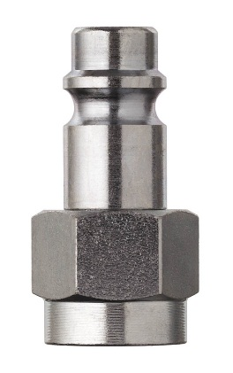
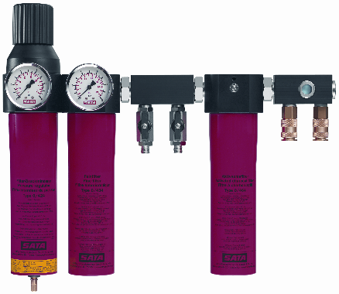
Air Volume vs. Air Pressure
Pressure drop in air hoses
  5/16” hose should not be used for painting
  Air-line hoses should be 3/8” at lengths up to 50 feet
Use high flow air fittings
  Adjust pressure with wall regulator – do not lower high air pressure at the gun
Hose diameter in inches |  | Pressure drop by hose length
 | Inlet psi | 15 feet | 35 feet | 50 feet
5/16” | 43 | 10.15 | 17.4 | 26.1
 | 58 | 14.5 | 23.2 | 31.9
 | 72 | 18.85 | 27.55 | 36.25
 | 87 | 21.75 | 31.9 | 40.6
3/8” | 43 | 3.34 | 5.51 | 8.7
 | 58 | 4.93 | 7.98 | 11.75
 | 72 | 6.24 | 9.14 | 13.34
 | 87 | 8.7 | 11.6 | 15.95

Slide 9
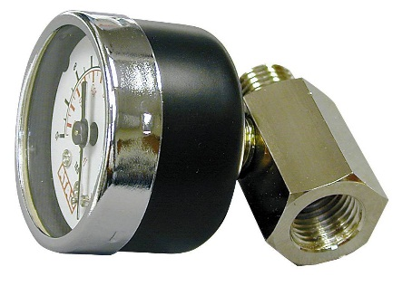
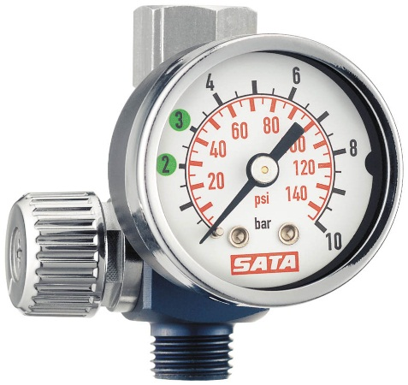
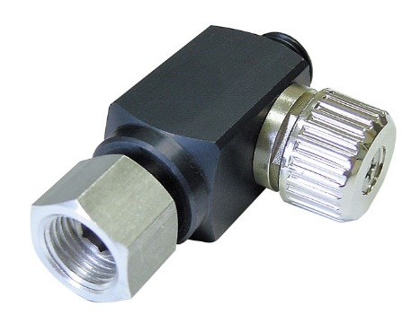
Air Volume vs. Air Pressure
Best options:
Digital gauge is best
Regular air gauge is 2nd
Cheater valve with gauge is 3rd
The ‘always guessing’ cheater valve should never be used! It’s impossible to know the air pressure, so it is not legal.
Courtesy of SATA

Slide 10
Gun distance – for Solvent “type” basecoats
5 inches to 7 inches* is best
Too far from panel
Too close to panel
*Distance may vary with some products. Follow manufacturers guidelines.
Notes:
Instructor Note: Some commercial coatings and waterborne finishes may require greater gun distances. The goal here is reduction of overspray, minimization of product sprayed to reduce emissions, and overall efficiency. Reinforce the proper distance based on product being sprayed to best achieve these goals.

Slide 11
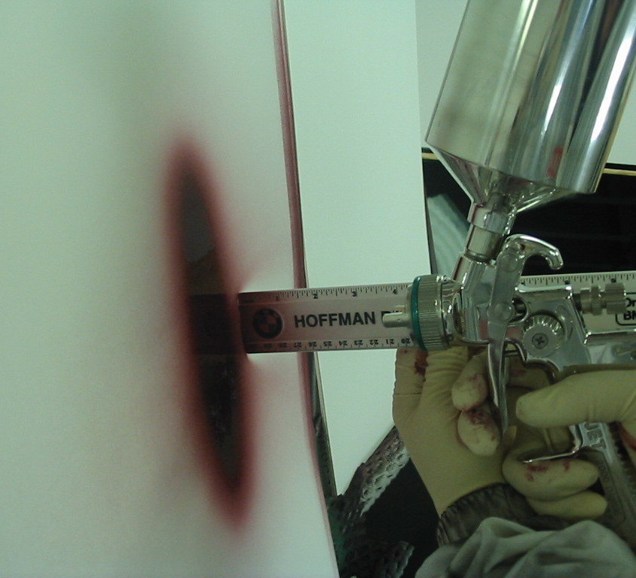
Gun distance – too close
4 inches
Very Wet
Small Pattern
High Transfer Efficiency
Must spray Fast
Courtesy of SATA

Slide 12
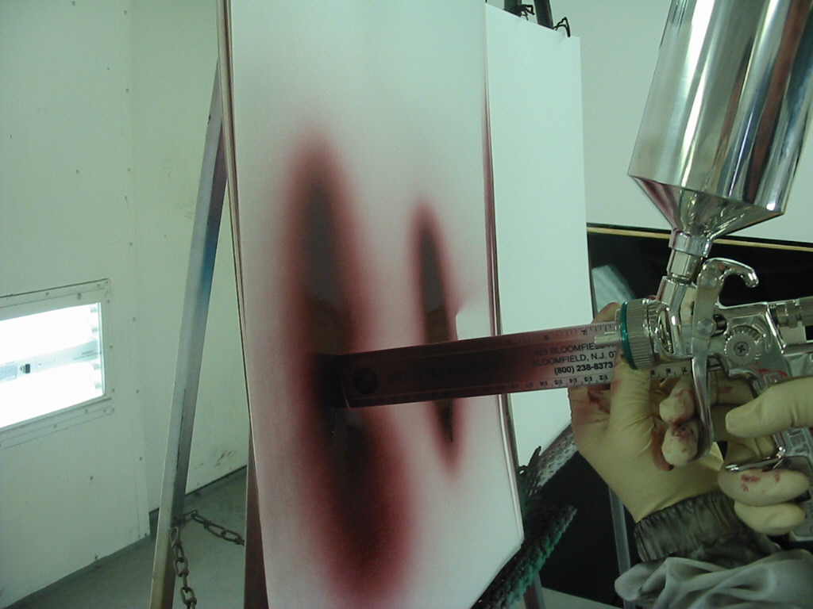
Gun distance – too far
8 Inches
Larger pattern
Not as wet
Must spray slower
Loss in Transfer Efficiency
Courtesy of SATA

Slide 13
Correct application – Solvent “type” Basecoats
Good Transfer Efficiency
Wet film
Uniform finish
Faster coverage
Better gloss in clearcoat
Key – right distance for the product
5” – 7”*
Gun perpendicular to surface
*Distance may vary with some products. Follow manufacturers guidelines.
Notes:
Instructor Note: As stated in a previous slide: Some commercial coatings and waterborne finishes may require greater gun distances. The goal here is reduction of overspray, minimization of product sprayed to reduce emissions, and overall efficiency. Reinforce the proper distance based on product being sprayed to best achieve these goals.

Slide 14
Fluid Tip Selection
Fluid tip selection is critical to efficient delivery of product
Select tip based on product and gun manufacturer recommendations
Recommendations can be found in Technical Data Sheets and Manuals at www.axaltacoatingsystems.com

Slide 15
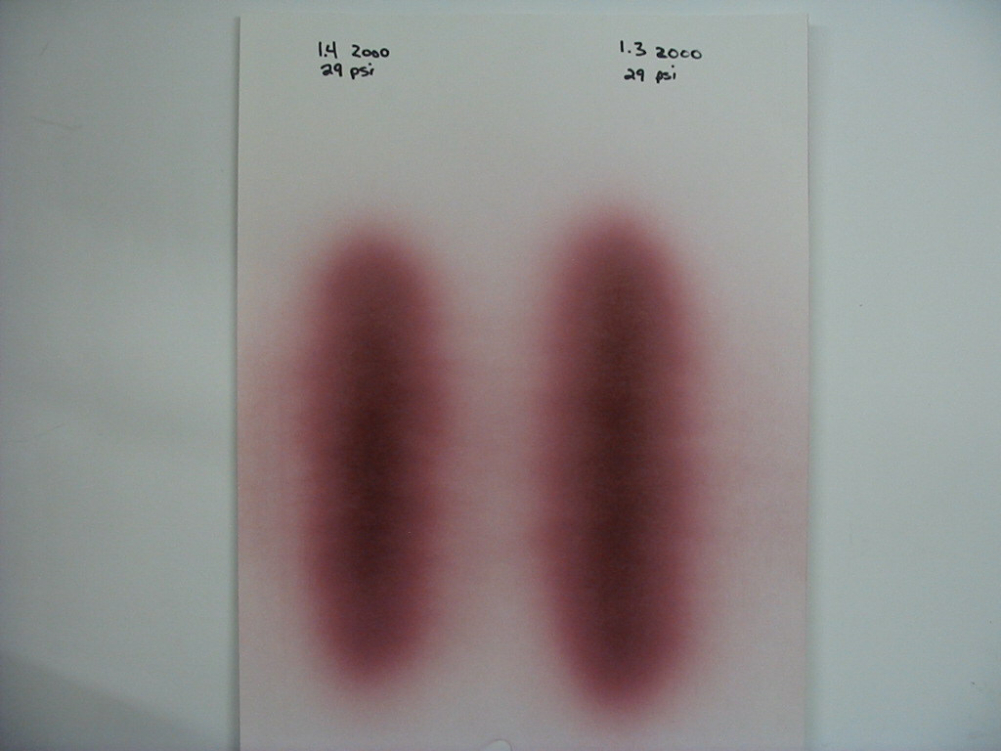
Fluid tip comparison and activity
Notice difference between a 1.4 and 1.3 tip, both sprayed at 29 psi with proper gun set ups:
Take time now to check the products and guns you use…
Notes:
ACTIVITY:
Review tech manual sheets and gun manufacturer recommendations for undercoats, basecoats and clearcoats. Each participant should identify products and guns used, and note proper fluid tip for each.

Slide 16
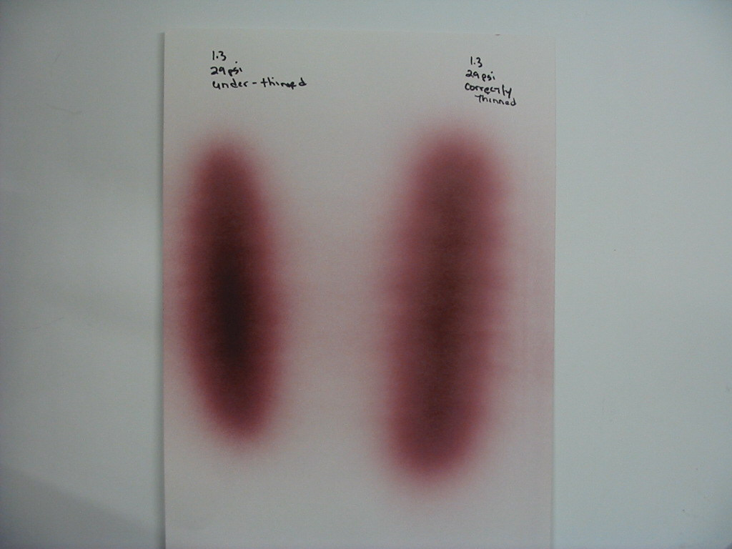
Viscosity
Properly thinned product results in uniform pattern and better results
Note difference between under-thinned and properly thinned material:

Slide 17
Overlap
Proper overlap with today’s guns is 65% - 75% for proper application
Proper overlap results in:
  Less mottling
  Less striping of metallic colors
  Consistent film build
  Even texture
  Material saving
65%
overlap
1st
75%
overlap
1st
2nd
2nd
3rd pass
3rd pass

Slide 18
Trigger technique and timing
To minimize overspray a new technique is required
Old practice of a wide sweep past the end of the panel needs to change. Minimize distance past panel and adjust trigger technique

Slide 19
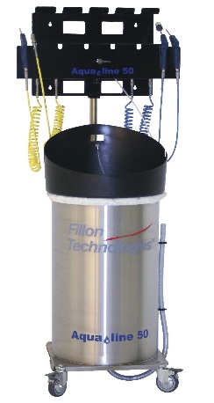
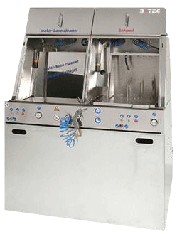
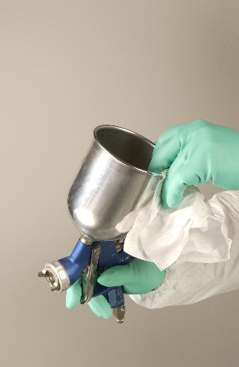
Gun Cleaning
Spraying solvent through the gun (creating an atomized mist) is NOT permitted
Enclosed gun cleaners are permitted for use; enclosed cleaners are required in some locations
Cleaning disassembled gun by hand is permitted except in locations where enclosed cleaners are required

Slide 20
Getting the most out of your paint
Tools that assist with mixing the right amount and minimizing wasted paint include:
Paint Volume Calculator
  Helps you mix the amount of paint needed to complete the job
Ounces per paint hour tool
  Guide to use initially, adjust as needed
Best Practices for managing waste

Slide 21
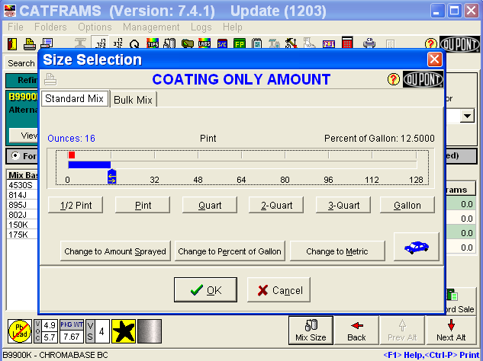
Paint Volume Calculator
    Click on the Car
Notes:
Instructor Note: be prepared to perform a demonstration of the Paint Volume Calculator.

Slide 22
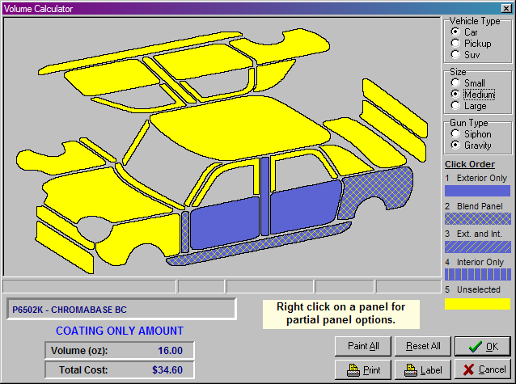
Paint Volume Calculator
To determine quantity of paint needed:
    Click on the panels to paint; double click on the blend panels

Slide 23
Recordkeeping
Some states, counties and local regulatory areas have specific rules. Please check with your local air quality authorities for additional training needs.
  Indiana has recordkeeping and reporting rules (326 IAC 8-10) that require each batch mixed to have the following:
    Batch or job identification number.
    Date batch made or job performed.
    Coating category, consistent with the coating categories in section 4(a) of this rule.
    Coating manufacturer’s name and identification number (such as 8035).
    Either the quantity used in making the mix or mix ratio.
    VOC content as supplied or packaged.

Slide 24
Recordkeeping
    Manufacturer’s name and identification number of added components, such as the following:
      Catalysts
      Reducers
      Hardeners
    Either the quantity of components added or the mix ratio used.
    For each surface preparation product used, the following information:
      Manufacturer’s name and identification number.
      Substrate to which it was applied.
      VOC content as supplied per calendar month for:
        Number of containers used.
        Volume of each container in suitable units such as quarts, gallons, pints, or other similar units and the mix ratio of components added.

Slide 25
Recordkeeping - ColorNet®
ColorNet® has recordkeeping capabilities, and may be set to track all of your needs.
Please insure it is set up for the rules in your area.
ColorNet® VOC Tracking 2.0:
Axalta Coating Systems customers have an independent obligation to determine proper use of their products and that their use is consistent with Federal, State and Local laws, rules and regulations.

Slide 26
Waste Management Best Practices
Wastes generated in a Collision Center may be considered hazardous by RCRA standards.
  RCRA – Resource Conservation and Recovery Act – regulates solid waste management
Additional information regarding hazardous waste management can be found at EPA website
https://www.epa.gov/saferchoice#best
https://www.epa.gov/saferchoice/autobody-refinishing-general-best-shop-practices
https://www.epa.gov/collision-repair-campaign
Notes:
Instructor Note: you may wish to print these documents prior to training and have available as a leave-behind.

Slide 27
Waste Management Best Practices
Type of Waste | Waste Management Guidance
Sanding Dust | Dispose of waste dust collected in vacuum sanders properly After wet sanding, allow waste to dry. Sweep up and dispose of dry waste properly. 
Used Paint Booth Filters | DO NOT DISPOSE of used filters containing Cr, Cd, Pb or other metals in garbage  
Used Paint Cup Liners | If the paint does not contain metals, used paint cup liners containing dried paint can be disposed of as non hazardous waste⇦
Empty Paint Cans | Cans containing dried paint⇦ must be disposed of as hazardous waste unless tested to demonstrate metals levels below limits.
Used solvent and paint waste | NEVER dispose of waste paint and solvent down storm drains, septic systems, or dry wells. Label all containers of used solvent and paint waste with the words “HAZARDOUS WASTE”., and consult a local hazardous waste disposal contractor for proper disposal
Shop towels | Disposable towels that have been contaminated with hazardous materials (solvents) must be disposed of as hazardous waste. Store towels contaminated with solvents in closed containers to avoid creating a fire or explosion hazard. Such towels should not be air dried before being put in the closed container
- some primers contain metals - unless tested to demonstrate metals levels below limits, filters must be disposed of as hazardous wastes. ⇦- if tested to be below limits, empty containers can be disposed of as non-hazardous wastes

Slide 28
EPA Rule 40 CFR Part 63 training review
A technician paints cars and light trucks at a local collision center. Is this technician required to have documented training under EPA Rule 40 CFR Part 63?
  □ Yes □ No
Which of the following help improve transfer efficiency?
  □ Spray gun set-up □ Gun distance □ Spray overlap □ All these
Where may coatings be sprayed under EPA Rule 40 CFR Part 63?
  □ Open shop floor □ Enclosed prep stations □ Enclosed booths □ Outdoors
How may spray guns be cleaned under EPA Rule 40 CFR Part 63?
  □ Spraying solvent into booth filter □ Enclosed gun cleaner or by hand
Does my shop have to notify the EPA that we are compliant to EPA Rule 40 CFR Part 63?
  □ Yes □ No

Slide 29
EPA Rule 40 CFR Part 63 training review
How often is painter recertification required?
□ Every 2 years □ Every 3 years □ Every 4 years □ Every 5 years
Is a facility that does not apply target HAPs automatically exempt from this rule?
□ Yes □ No
Are non-refillable aerosols exempt from this rule?
□ Yes □ No
This rule requires my shop to document that the spray booth filters have 98% or greater efficiency
□ Yes □ No
Proper overlap for spray coatings is
□ 45% - 55% □ 55% - 65% □ 65% - 75% □ 75% - 85%

